Slide 1
Case Based Reasoning and Financial Decision Making
By Kostas Hatalis

Slide 2
Contents
Introduction to Finance
Case-Based Reasoning for Market Surveillance
Financial Applications of Fuzzy CBR to Residential Property Valuation
A CBR Approach for Predicting Bank Lending Decisions
A Neural Network with a Case Based Dynamic Window for Stock Trading Prediction
A Web-based CBR Agent for Financial Forecasting
Concluding Remarks

Slide 3
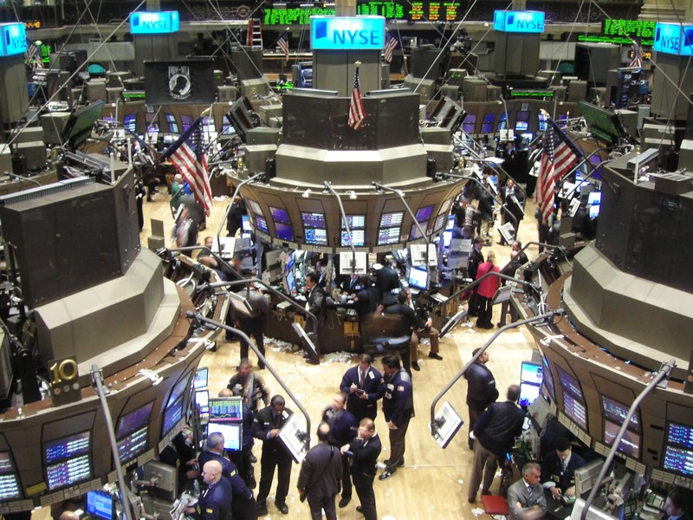
Financial Decision Making
Stock Trading
Real-estate Valuation
Bank Lending
Forecasting

Slide 4
Market Surveillance
Good starting point to introduce CBR to finance.
Exchanges and investment firms have these departments for market surveillance.
But what is market surveillance?

Slide 5
Market Surveillance
Goal: explain price movements
This is a difficult task!
Past methods: use technical indicators and rule based expert systems
Rule-based expert systems have flaws
Do not learn
Unable to deal with new problems
Complex, expensive, and time consuming
What to use beyond expert systems?
Hint – we all know this

Slide 6
Market Surveillance
CBR is easier to find solutions and add new knowledge!
Paper presents a new approach to knowledge-based market monitoring:
Intelligent Market Monitor (IMM)

Slide 7
Intelligent Market Monitor
Basic Idea:
To add more knowledge to a case-based system all the user has to do is add more cases and let the inductive indexing mechanism re-structure a classification tree.
Case Retrieval:
A binary decision tree is used for case retrieval. The importance of each feature in the tree is determined by the correlation between the feature and the variance in case outcome.
Note, this was developed late 1980’s, so CBR was a brand new idea back then.

Slide 8
Runtime Data Flow (from [1])
TSE
Database
Price
Alert
CBR Run-Time
Alert
Filter
Transaction
Record
TR
Alerts
Case Record Construction
Volume
Alert
Decision Tree Analysis
Revised Transaction Record
Non
Alerts
Case Base

Slide 9
What does a Case in IMM look like?
Problem: Information in a case describing a situation
Transaction info (volume and price of a stock)
Recent trades of that specific stock
Price trends of the industry
Exchanges the stock trades on
Recent economic data
Recent news story about that company
Solution: There are 15 possible solutions
Ex: The stock is moving with its industry trend
Ex: Recent news caused sharp changes in price
Unusual transactions with no explanations warrant investigation by a real person.

Slide 10
Testing and Conclusion
Cognitive System’s CBR was tested on the Toronto Stock Exchange
Proven to be fast and reliable
Target accuracy rate of 80-90% for alert explanations
Future work proposed CBR be applied to analyzing banking decisions and estimating value of assets
Next two papers cover these subjects!

Slide 11
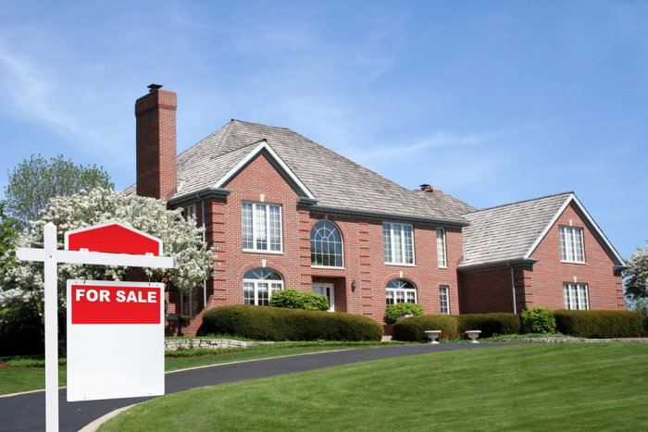
Financial Applications of Fuzzy CBR to Residential Property Valuation
Residential Property Valuation - is the process of determining the value of a house for given market conditions.

Slide 12
Residential Property Valuation
Current way to value a house is to visit it. But what happens if you want to value 1000 houses?
This process takes too long and is expensive!
Another common method used by humans is sales comparison where past sales are compared to the current one to determine sale price.
But human estimates may be inaccurate.
Ideally we would like this approach to be automated.
CBR is a perfect fit here!

Slide 13
PROFT Property Financial Information Technology
Is a system that enhances CBR with fuzzy predicates expressing preferences in determining similarities between subject home and comparable homes.
Goals:
Find the most similar houses.
Located close to subject house.
Sold not too long ago.
Select balanced subset of most promising similar homes.

Slide 14
PROFIT Approach
Retrieve recent sales from a case based using a small number of features to find comparables.
Compare the subject property with the retrieved cases and calculate similarity measure from the aggregation of fuzzy preference values.
Adjust the sales price of the retrieved cases to reflect their differences from the subject using a rule set.
Aggregate the adjusted sales prices of retrieved cases, selecting the best comparables, deriving a single value estimate for the subject
Qualify the estimate with a confidence value (utility metric).

Slide 15
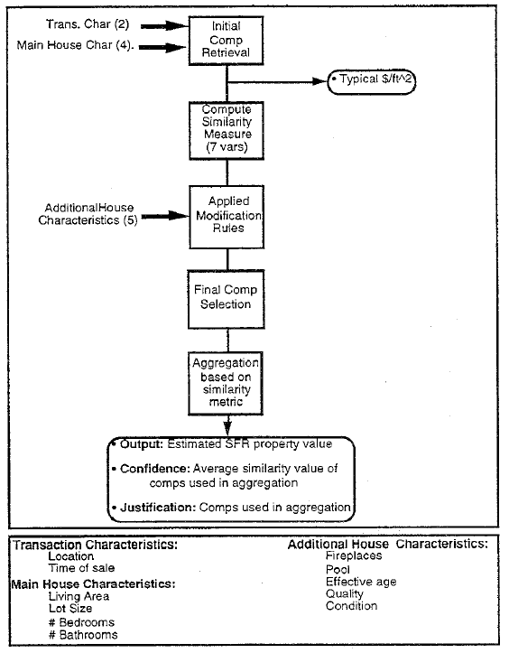
(from [2])
Case-base consists of cases of properties in CA sold in the last 5 years. A case description is the sale record.
Selection uses six attributes:
Address
Date of sale,
Living area
Lot area
Number of bathrooms and bedrooms

Slide 16
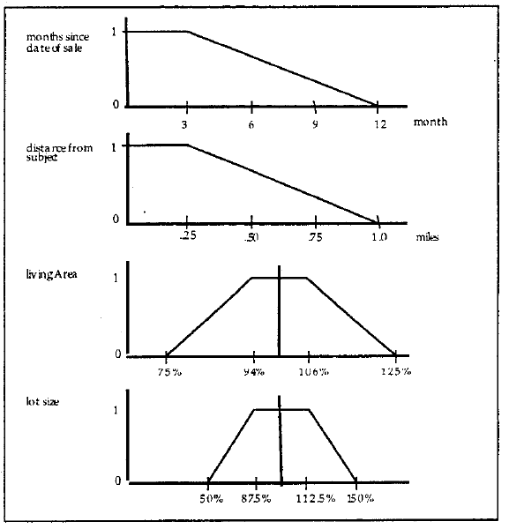
Domain specific SIM

Slide 17
Domain specific SIM
Preference Weighting and Aggregation (example):

Slide 18
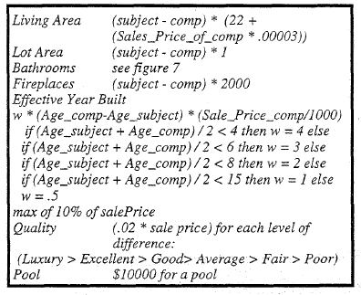
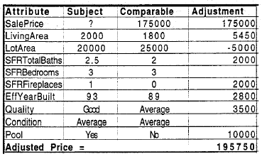
Case Retrieval
After SIM is calculated, on average 22 cases to compare with are found. However we want to limit them to 4-8 cases of which we will use to aggregate a price from.
Before this, all cases undergo adjustment in their sales price (from [2]_:

Slide 19
Case Retrieval
To further limit cases, rules are applied to filter out cases until we have the best ones only. For example:
No single adjustment should be larger than 10% of sales price.
Net adjustment should no exceed 25% of sales price.
The unit price for living area of the comparables should not vary more than 15% from each other and should bracket that of the subject.
Comparables should be as close as possible to the subject.
The value estimated for the subject should be bracketed by the sales price of the comparables

Slide 20
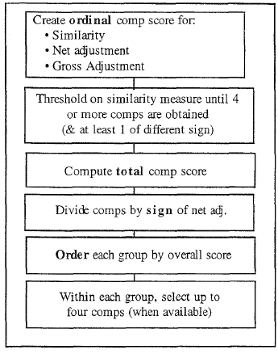
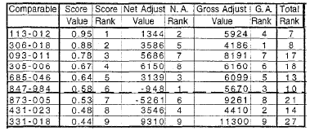
Case Retrieval (almost done!)
After rules are applied and we have a set of a dozen cases or so, we apply a ranking method to get the top 4-8 cases (from [2]):

Slide 21
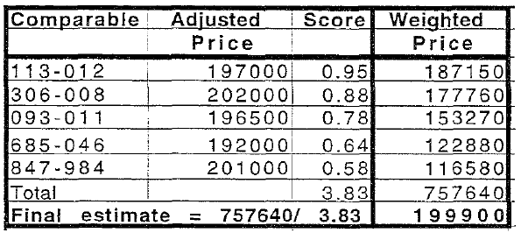
Estimating Sales Price of Subject House
After the best cases are found (ex the top 5 from the previous ranks), their prices are combined to produce the final estimate for sales price of our current home:

Slide 22
Utility Matric
Now that we found a good estimate for the sales price we need to see just HOW good that estimate really is:
A confidence score is attached to every case.
Five characteristics are used to calculate the confidence values:
Number of cases found in initial retrieval
Average of the SIM values for the 4 best cases
Typicality of the problem with respect to the case base.
Span of adjusted sales prices of highest confidence solutions.
Distribution of adjusted sales prices of highest confidence solutions.

Slide 23
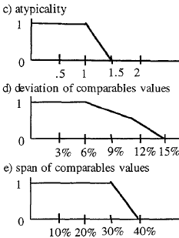
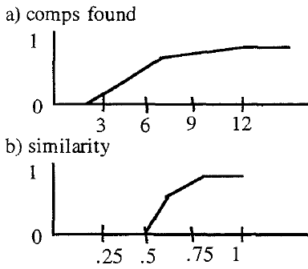
Utility Matric
These characteristics are evaluated using fuzzy membership functions which map the value of each parameter into a confidence interval:

Slide 24
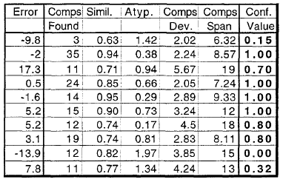
Utility Matric
These confidence values are then aggregated into a final confidence value

Slide 25
Conclusion
PROFIT (the CBR system) is quite scalable and able to process 1000’s of transactions.
Was compared to several other methods (from [2]):

Slide 26
A CBR Approach for Predicting Bank Lending Decision
Banks play an important role in the economy, since they channel funds from households and enterprises which are net savers to those who are net borrowers
There are a number of flaws in financial markets, such as in the granting of credit, which may hamper the way enterprises and households spend.
For the most part, analysts make economic decision and develop forecasts on the economy ad hoc, by looking at simple statistical and quantitative indicators.
How has this worked out so far?

Slide 27
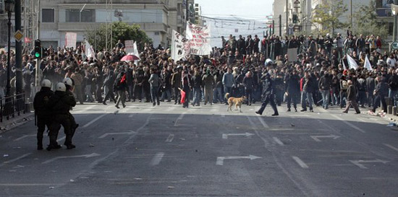
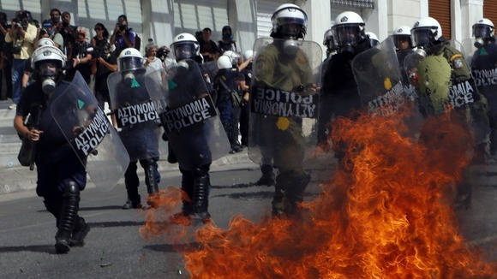
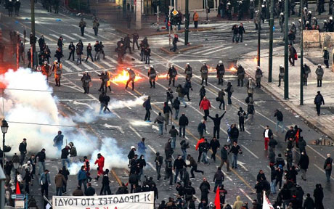
Not So Well! - Eurozone Crisis
For instance, European lending banks gave Greece 100’s billions of euros without knowing Greece’s full credit conditions and economic health.
NOW GREECE IS BURNING!
And the rest of the Eurozone is in crisis. But what to do about this?

Slide 28
Smart Solution: CBR
GOAL: forecasts the credit standards and conditions used by the banks when granting credit. It also provides an evaluation of the objective and subjective factors underlying the forecast.
IE the CBR system developed adapts past cases of credit decisions to forecast the future credit granting behavior of economic agents.
The CBR system developed in this paper uses qualitative data collected through the Bank Lending Survey related to the Portuguese banks.
Is a good proposal for the kind of systems that the rest of the Eurozone could adapt to prevent bad forecasts and decisions.

Slide 29
Extension to CBR
Traditional CBR extended with the possibility of representing hypotheses - which are used to capture subjective factors that influence credit decisions (economic sentiment).
This simple mechanism allows the system to predict the decisions that would be made if the specified hypotheses were satisfied. That is, the answer is X if the hypothesis H is holds

Slide 30
Case Structure
Case(Condition, Economic Sentiment, Decision)
The problem specifies a set of objective factors relating to a given situation in which the credit granting decision is to be made.
The hypothesis is a single condition representing the economic sentiment of the decision-maker
The solution is the decision regarding credit granting. It specifies a set of actions relative to credit granting.

Slide 31
The Condition
Case(Condition, Economic Sentiment, Decision)
Reflects objective factors in the survey which are taken into account in the decision-making by the economic agent.
The conditions made up of a series of literals:
[C1, C2, …, Cn]
Each literal Ci has the following structure:
Factor(bank, factor tendency)
This can represent a relevant characteristic of the domain, such as the cost of funds.
Bank – refers to the credit institution
Factor Tendency – refers to the tendency associated to the factor. The values allowed are:
increase, unchanged, decrease, and non-existence.

Slide 32
Economic Sentiment
Case(Condition, Economic Sentiment, Decision)
Expresses the combination of the previous features. Possible values are as follow:
very optimistic
optimistic
neutral
pessimistic
very pessimistic
This is the hypothesis and ask if we should grant credit or not.

Slide 33
Decision
Case(Condition, Economic Sentiment, Decision)
Is the predicate of the solution and represents the behavior of the bank related to the credit decision. The predicates considered are:
Approval of loans
Collateral requirements
Maturity
Spread
A decision is made of a set of literals:
[D1, D2, …, Dm]
where each literal Dj has the following structure:
Decision(bank, decision tendency)

Slide 34
Case Example
*We will look at a full CBR with all the steps
example later.

Slide 35
Case Similarity
The basis for computing the similarity between cases weights the similarity associated to the condition.
Two levels of similarity:
SIM for a first assessment of the cases
less restrictive SIM, for a further assessment when no cases found from first similarity
If various cases are found with the same degree of similarity, the economic analyst will have to decide on the best solution.

Slide 36
Case Similarity
The similarity of two cases results from weighting the similarity of the with the similarity of the Hypothesis. The result derives from the following calculation:
- Calculation of the similarity of the Condition (S1)
- Calculation of the similarity of the Hypothesis (S2)
- Calculation of general similarity (S) : S = S1×S2.
S1=
Ddim = differences between number of literals in the problem and in the case.
SSim = sum of literals in the problem and the cases
SDif = sim of the differences found by comparing elements of the problem with a case
S2 = 1 if sentiment the same
S2 = 0.9 if tendencies close
S2 = 0 else

Slide 37
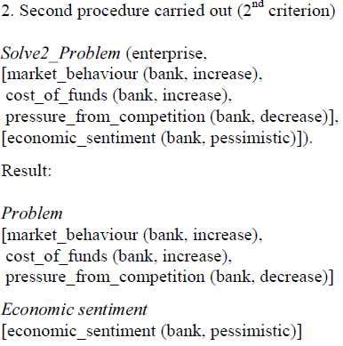
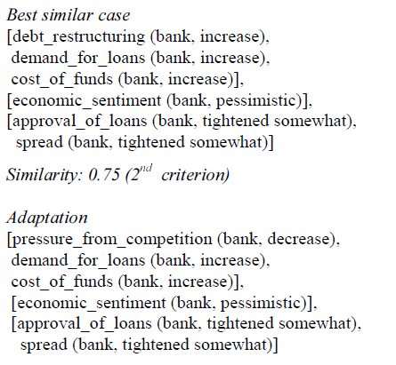
Full Example
Let us take the following economic case:
- Market behavior is improving,
- The cost of funds is increasing,
- Competition between the banks is decreasing,
- There is a pessimistic economic sentiment as regards the economy in general.

Slide 38
Conclusion
Results show that the system provides good quality predictions of the economic agents who are granting loans.
The system correctly predicted 90% of the approving the loan decisions

Slide 39
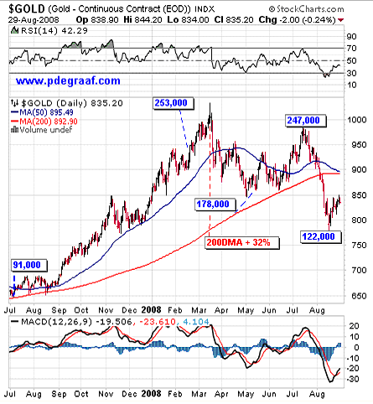
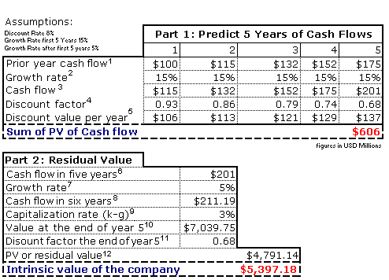
Next Topic: Stock Trading Prediction
Stock Market is vital for world economy and main source for any type of investment.
Predicting stock data with time series analysis is VERY difficult! Most of the time it’s actually random.
Traders use Fundamental Analysis and Technical Analysis to forecast future price movements. But what are these?

Slide 40
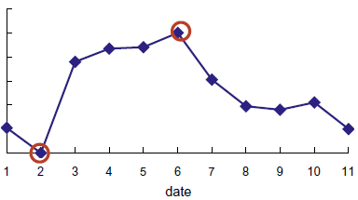
Case Based Dynamic Window Neural Network
The system proposed is called CBDWNN and is a combination of dynamic time windows, case based reasoning (CBR), and neural network for stock trading prediction.
GOALS
Screen out potential stocks according to relative indicator.
Develop an efficient and suitable forecast model for buy/sell decisions.
The main purpose of this study is
to predict the right turning points!
What’s a Dynamic Window?

Slide 41
Dynamic Window
CBR is applied as a dynamic window search to assist the BPN to fine tune the trading decision (on next slide).
Case based dynamic window is a way to search the most similar scenario from the previous stock data and predict the stock price fluctuation of the next day according to the adaptation of similar patterns.

Slide 42
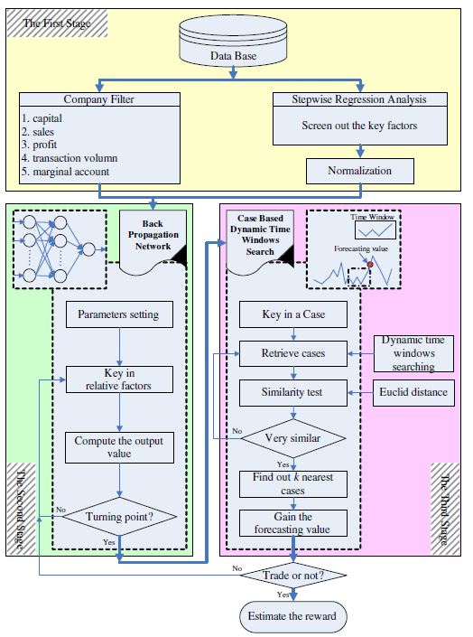
Three different stages:
Screen out potential stocks and the important influential factors.
Use back propagation network (BPN) to predict the buy/sell points (wave peak and wave trough) of stock price.
Adopt case based dynamic window (CBDW) to further improve the forecasting results from BPN.
*From [4]

Slide 43
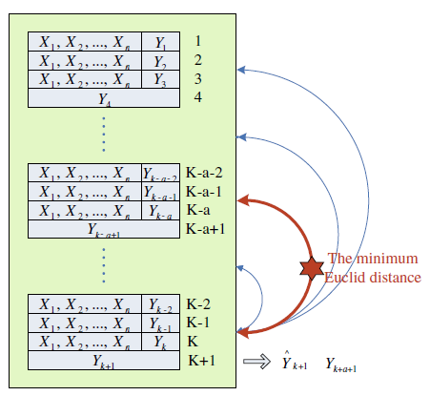
Case Retrieval
When the time period is determined, the dynamic time windows search will be processed.
If an investor wants to forecast the stock price fluctuation of the next day, by using mapping process, the most similar time window can be found.
If sim is over a threshold, the case is retrieved from the stock data. More then one case may be retrieved at a time.
*From [4]

Slide 44
Case Reuse
Cases that have a high performance (high % increase over time) will be used in the forecast of future stock prices.
The weighted average of these cases is taken.

Slide 45
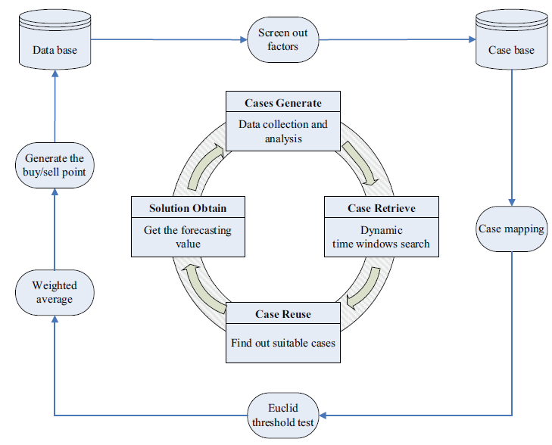
*From [4]

Slide 46
Conclusion
Nine different stocks with different trends: upward, downward and steady, were tested and one individual stock (AUO) was studied as case example.
The rates of return for upward, steady, and downward trend stocks are higher than 93.57%, 37.75%, and 46.62%, respectively.
…all very promising and better than using CBR or BPN alone!

Slide 47
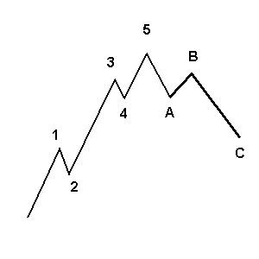
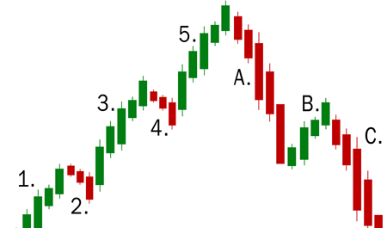
A Web-based CBR Agent for Financial Forecasting
Another more simpler way to apply CBR to stock trading!
Base cases on the characteristics of wave forms inside the track of the daily stock losing prices.
Wave propagations are defined as some signals, which are able to forecast the future conditions of the stock price movement.

Slide 48
Example Stock Movement

Slide 49
A Web-based CBR Agent for Financial Forecasting
CBR module needs to make use of the analysis indicators with respect to the dates in knowledge database and to construct wave-unit based data objects, extracting every feature of the wave patterns.
The knowledge database consists of daily stock high/low/close prices with analysis indicators such as RSIs, moving averages of price, and corresponding trading volume.

Slide 50
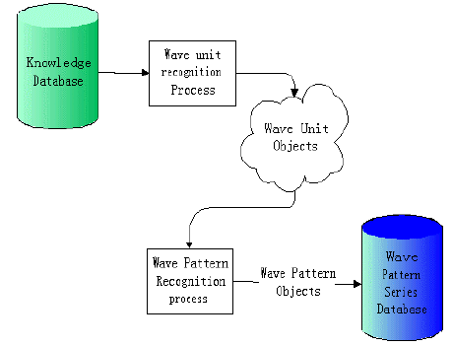

Slide 52
Concluding Remarks
CBR has a bright future in the world of economic and financial decision making and forecast.
Could make markets and economies more efficient.

Slide 53
References
[1] Paul Buta, Ralph Barletta, Case-Based Reasoning for Market Surveillance, IEEE (1991)
[2] Piero Bonissone, William Cheetham, Financial Applications of Fuzzy CBR to Residential Property Valuation, IEEE (1997).
[3] Maria Teodoro, Luis Botelho, A CBR Approach for Predicting Bank Lending Decisions, (2004)
[4] Pei Chang, Chen Lu, Jun Lin, Chin Fin, Celeste Ng, A neural network with a case based dynamic window for stock trading prediction, Expert Systems with Applications (2009).
[5] James N. K. Liu, Tommy T.S. Leung, A Web-based CBR Agent for Financial Forecasting, (2001)

Slide 54
Thank You! Any Questions?

